Slide 1

INSTITUTE: UIE (AIT-CSE)
Computer Networks CST- 348
Lecture – 1.8 and 1.9
Introduction to Physical Layer and Multiplexing, Modem
By : Dr. Monica Luthra(e9836)
DISCOVER . LEARN . EMPOWER

Slide 2

Course Objectives
CO Number | Title
CO1 | Describe the important networking concepts
CO2 | Understand concept of network reference models and protocols
CO3 | Apply the concepts of routing algorithms on various networks
CO4 | Identify mechanism to handle traffic and control on congestion
CO5 | Identify and understand connection establishment techniques and features

Slide 3

Course Outcomes
After this course student will be able to:
To bring together several key of Computer network design and architecture
To Familiarize the student with the basic taxonomy and terminology of the computer networking area.
To Allow the student to gain expertise in some specific areas of networking such as the design and maintenance of individual networks.

Slide 4

Physical Layer
The physical layer is the first and lowest layer of the Open System Interconnection Model (OSI Model.)
The physical layer (also known as layer 1) deals with bit-level transmission between different devices and supports electrical or mechanical interfaces connecting to the physical medium for synchronized communication.
This layer plays with most of the network’s physical connections—wireless transmission, cabling, cabling standards and types, connectors and types, network interface cards, and more —as per network requirements.
The physical layer does not deal with the actual physical medium (like copper, fiber, etc.)

Slide 5
Services provided by Physical Layer(Functionalities)
Cables and connectors
Physical topologies
Hardware (Repeaters , Hubs)
Transmission Modes
Encoding
Multiplexing

Slide 6
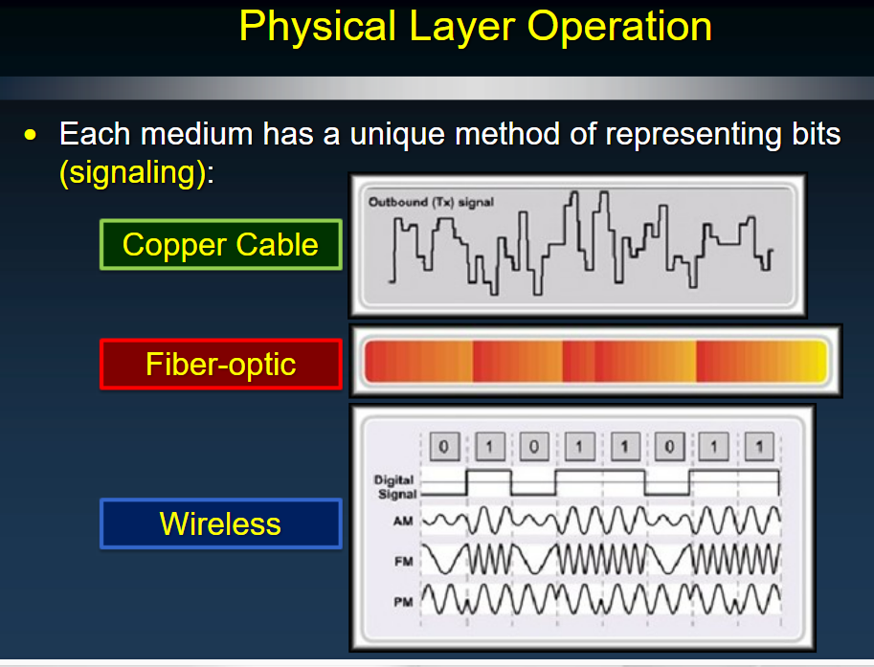
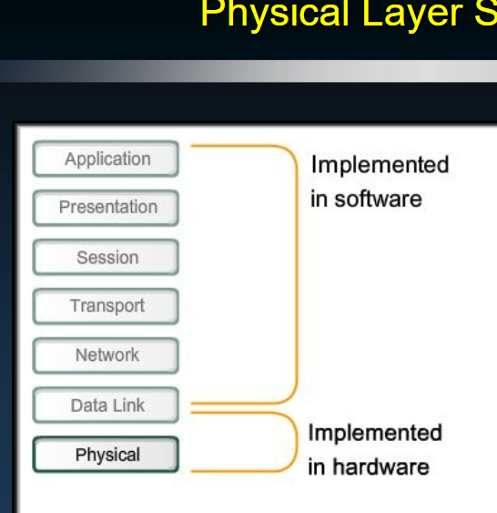
cables

Slide 7
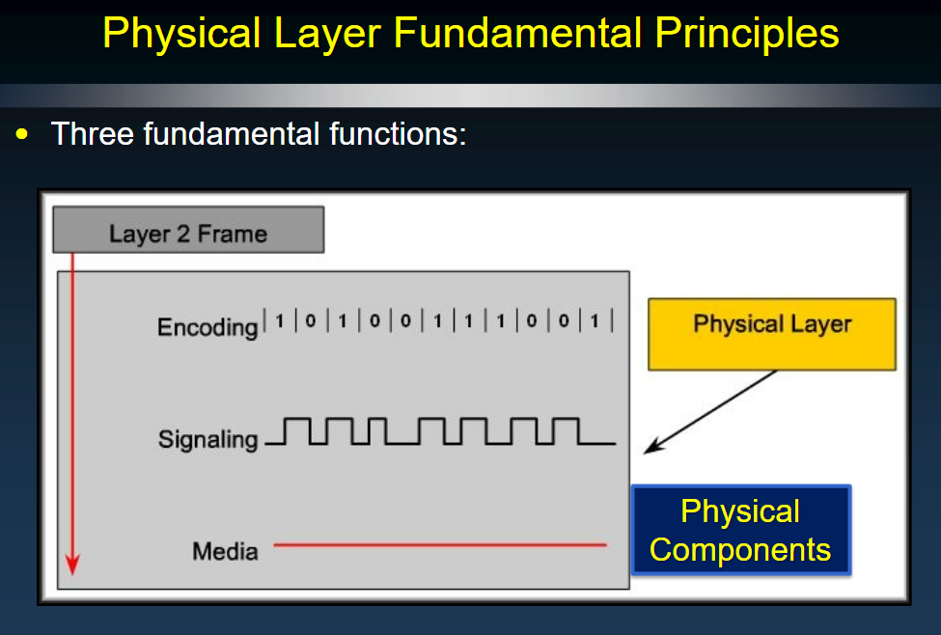
Role of Physical layer

Slide 8
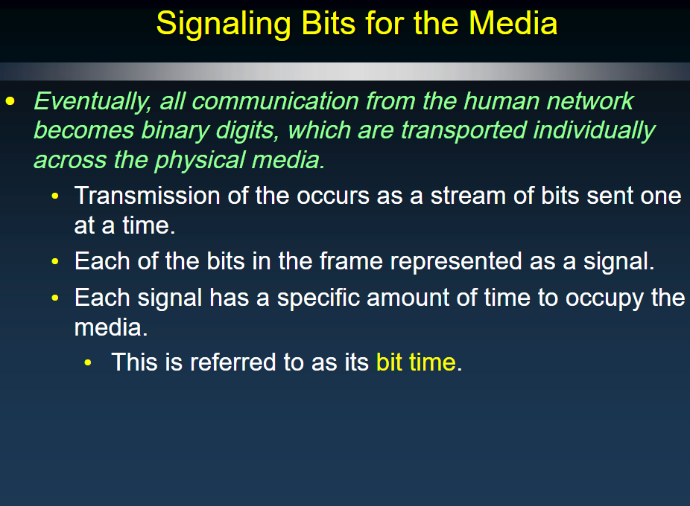
Encoding

Slide 9
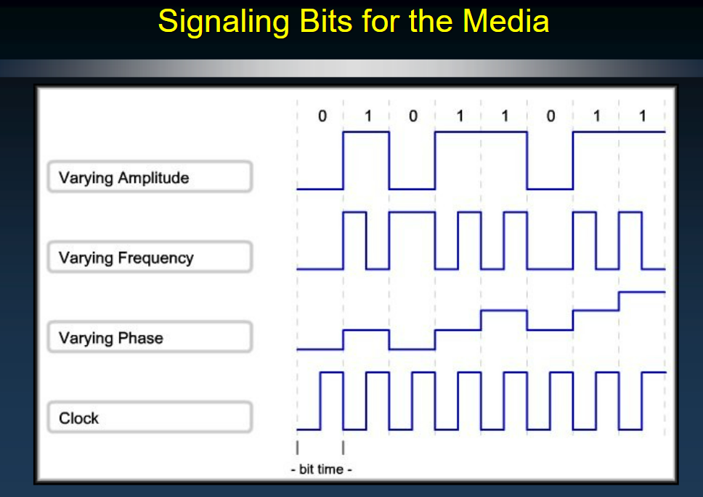
Types of signals

Slide 10
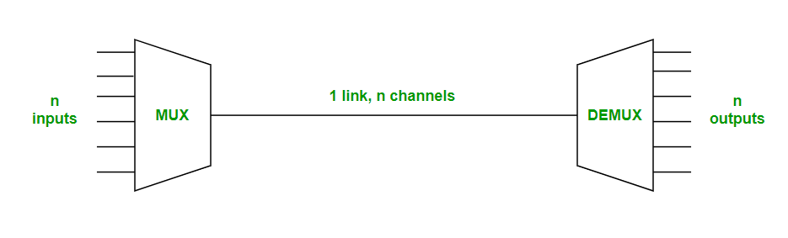
Multiplexing
Multiplexing is the sharing of a medium or bandwidth. It is the process in which multiple signals coming from multiple sources are combined and transmitted over a single communication/physical line.
Image Source : https://www.geeksforgeeks.org/types-of-multiplexing-in-data-communications//

Slide 11
Types of Multiplexing
There are two types of Multiplexing :
Frequency Division Multiplexing (FDM)
Time-Division Multiplexing (TDM)
1. Frequency Division Multiplexing :
Frequency division multiplexing is a defined as a type of multiplexing where the bandwidth of a single physical medium is divided into a number of smaller, independent frequency channels.
2. Time Division Multiplexing :
Time division multiplexing is a defined as a type of multiplexing where in FDM, instead of sharing a portion of the bandwidth in the form of channels, in TDM, time is shared. Each connection occupies a portion of time in the link.

Slide 12
Modem
Introduction:
A modem [Modulator -Demodulator] is a device.
Data communication means transmitting digital information form one computer to other computers through the comuunication channels.
Communicate equipment used for long distance data transfer through telephone lines.
A pair of modems are needed to communication

Slide 13
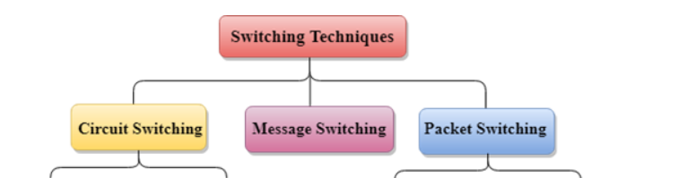
Switching techniques
In large networks, there can be multiple paths from sender to receiver. The switching technique will decide the best route for data transmission.
Switching technique is used to connect the systems for making one-to-one communication.
Classification Of Switching Techniques

Slide 14
Circuit Switching
Circuit switching is a switching technique that establishes a dedicated path between sender and receiver.
In the Circuit Switching Technique, once the connection is established then the dedicated path will remain to exist until the connection is terminated.
Circuit switching in a network operates in a similar way as the telephone works.
A complete end-to-end path must exist before the communication takes place.
In case of circuit switching technique, when any user wants to send the data, voice, video, a request signal is sent to the receiver then the receiver sends back the acknowledgment to ensure the availability of the dedicated path. After receiving the acknowledgment, dedicated path transfers the data.
Circuit switching is used in public telephone network. It is used for voice transmission.
Fixed data can be transferred at a time in circuit switching technology.

Slide 15
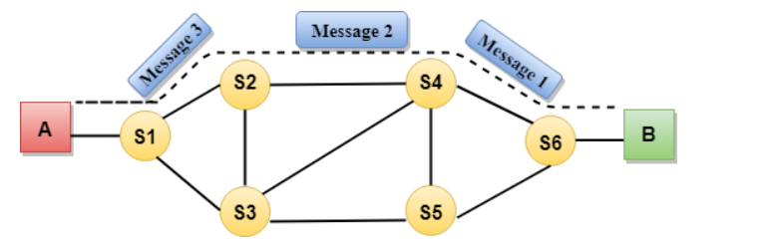
Circuit establishment
Data transfer
Circuit Disconnect
Circuit establishment
Data transfer
Circuit Disconnect
Circuit establishment
Data transfer
Circuit Disconnect

Slide 16
Advantages Of Circuit Switching:
In the case of Circuit Switching technique, the communication channel is dedicated.
It has fixed bandwidth.
Disadvantages Of Circuit Switching:
Once the dedicated path is established, the only delay occurs in the speed of data transmission.
It takes a long time to establish a connection approx 10 seconds during which no data can be transmitted.
It is more expensive than other switching techniques as a dedicated path is required for each connection.
It is inefficient to use because once the path is established and no data is transferred, then the capacity of the path is wasted.
In this case, the connection is dedicated therefore no other data can be transferred even if the channel is free.

Slide 17
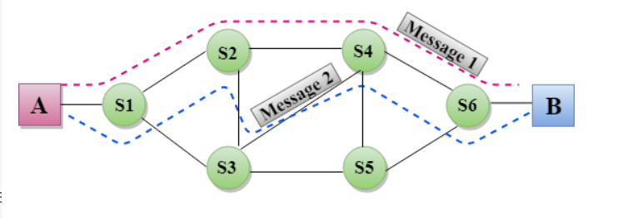
Message Switching
Message Switching is a switching technique in which a message is transferred as a complete unit and routed through intermediate nodes at which it is stored and forwarded.
In Message Switching technique, there is no establishment of a dedicated path between the sender and receiver.
The destination address is appended to the message. Message Switching provides a dynamic routing as the message is routed through the intermediate nodes based on the information available in the message.
Message switches are programmed in such a way so that they can provide the most efficient routes.
Each and every node stores the entire message and then forward it to the next node. This type of network is known as store and forward network.
Message switching treats each message as an independent entity.

Slide 18
Advantages Of Message Switching
Data channels are shared among the communicating devices that improve the efficiency of using available bandwidth.
Traffic congestion can be reduced because the message is temporarily stored in the nodes.
Message priority can be used to manage the network.
The size of the message which is sent over the network can be varied. Therefore, it supports the data of unlimited size.
Disadvantages Of Message Switching
The message switches must be equipped with sufficient storage to enable them to store the messages until the message is forwarded.
The Long delay can occur due to the storing and forwarding facility provided by the message switching technique.

Slide 19
Packet Switching
The packet switching is a switching technique in which the message is sent in one go, but it is divided into smaller pieces, and they are sent individually.
The message splits into smaller pieces known as packets and packets are given a unique number to identify their order at the receiving end.
Every packet contains some information in its headers such as source address, destination address and sequence number.
Packets will travel across the network, taking the shortest path as possible.
All the packets are reassembled at the receiving end in correct order.
If any packet is missing or corrupted, then the message will be sent to resend the message.
If the correct order of the packets is reached, then the acknowledgment message will be sent.

Slide 20
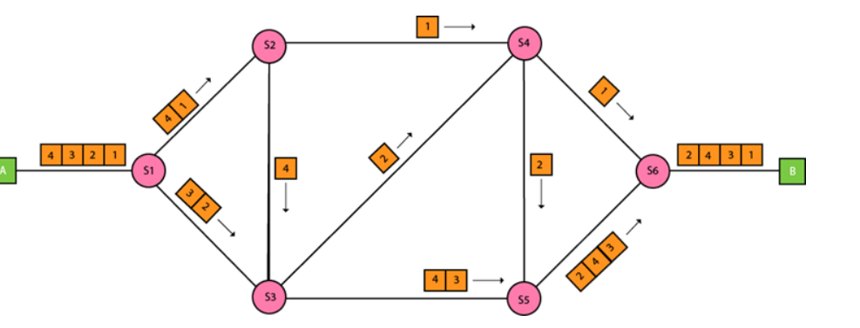

Slide 21
Approaches Of Packet Switching:
There are two approaches to Packet Switching:
Datagram Packet switching:
It is a packet switching technology in which packet is known as a datagram, is considered as an independent entity. Each packet contains the information about the destination and switch uses this information to forward the packet to the correct destination.
The packets are reassembled at the receiving end in correct order.
In Datagram Packet Switching technique, the path is not fixed.
Intermediate nodes take the routing decisions to forward the packets.
Datagram Packet Switching is also known as connectionless switching.

Slide 22
Virtual Circuit Switching
Virtual Circuit Switching is also known as connection-oriented switching.
In the case of Virtual circuit switching, a preplanned route is established before the messages are sent.
Call request and call accept packets are used to establish the connection between sender and receiver.
In this case, the path is fixed for the duration of a logical connection.

Slide 23
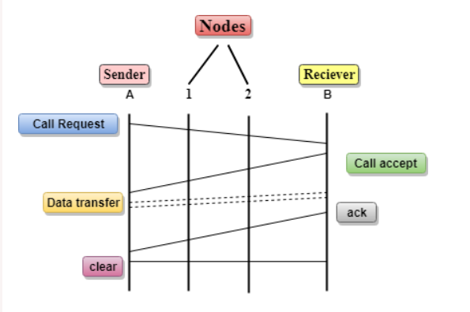
In the above diagram, A and B are the sender and receiver respectively. 1 and 2 are the nodes.
Call request and call accept packets are used to establish a connection between the sender and receiver.
When a route is established, data will be transferred.
After transmission of data, an acknowledgment signal is sent by the receiver that the message has been received.
If the user wants to terminate the connection, a clear signal is sent for the termination.

Slide 24
Key Points
Circuit switching and multiplexing hardware control of multiplexed digital signals.
A modem [Modulator -Demodulator] is a device.
Multiplexing is the sharing of a medium or bandwidth.
Modulates the process of converting a signal from one form to another so that it can be physically transmitted over a communication channel

Slide 25
References
https://www.geeksforgeeks.org/basics-computer-networking/
https://www.youtube.com/watch?v=VwN91x5i25g&list=PLBlnK6fEyqRgMCUAG0XRw78UA8qnv6jEx
http://www.svecw.edu.in/Docs%5CCSECNLNotes2013.pdf
https://www.cloudflare.com/learning/ddos/glossary/open-systems-interconnection-model-osi/

Slide 26
THANK YOU
For queries
Email: monica.e9836@cumail.in

